Slide 1
AUTOCORRECTOR FEATURE USING NLP
by
J MANOJKUMAR
220701524
Guide
Dr. V. Auxilia Osvin Nancy, M.Tech, Ph. D.

Slide 2
Introduction
Spelling correction is really important for making things easier for users when they're communicating online, whether they're typing in a document or searching on Google. This paper introduces a new autocorrect system built with Python and a user-friendly interface made with Tkinter. The app spots and fixes typos by using natural language processing, specifically looking at how similar words are (edit distance) and how often words show up (word frequency analysis). After going through a bunch of text data, the system suggests possible corrections when the user types something. This project shows how useful NLP and string similarity can be, and it also gives us a basic tool to build more complex language apps on.

Slide 3
Literature Survey
Autocorrection systems have been a topic of research and development for many years, primarily in the fields of natural language processing (NLP), information retrieval, and computational linguistics. Various algorithms and models have been proposed and implemented to improve the accuracy and speed of correcting typographical errors in user inputs. One of the foundational approaches in spell correction is based on edit distance, also known as Levenshtein Distance, introduced by Vladimir Levenshtein in 1966. This method calculates the minimum number of operations (insertion, deletion, substitution, or transposition) required to transform one word into another. It forms the basis of many traditional autocorrect systems.

Slide 4
Literature Survey
Peter Norvig's algorithm for spelling correction, published in 2007, is another widely recognized model. It combines edit distance with word probability derived from a text corpus. The algorithm generates a list of candidate corrections and ranks them based on frequency, making it both simple and efficient for many use cases. Norvig’s method has been widely adopted in educational projects due to its clarity and effectiveness. Modern systems such as those used by Google Search, Microsoft Word, and Grammarly apply more advanced techniques involving contextual analysis, n-gram models, deep learning, and transformer-based language models like BERT and GPT. These systems not only correct spelling errors but also take the surrounding words into account to offer context-aware suggestions.

Slide 5
Objectives
The objective of this project is to develop a simple yet effective autocorrector application using Python. The main goal is to assist users by automatically identifying and correcting spelling mistakes in individual words entered through a graphical user interface. This is achieved by comparing the user’s input against a large dataset of English words and calculating the most probable correction based on word similarity and frequency. The system makes use of edit distance algorithms, which involve basic operations like inserting, deleting, replacing, or transposing characters in a word to find potential correct alternatives.
.

Slide 6
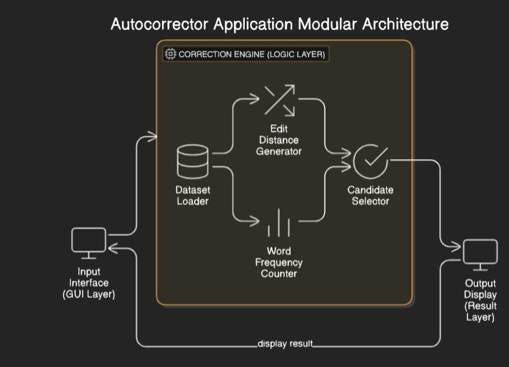
System Architecture

Slide 7
Methodology
The autocorrector is a smart system that relies on a set of rules. It cleverly combines several techniques, such as preparing the text, figuring out how different words are, and analyzing how often words appear. To start, it loads up a massive collection of English text. Then, it cleans things up by turning everything to lowercase and getting rid of punctuation, numbers, and any special characters. After that, it breaks the text down into individual words and creates a dictionary that keeps track of how often each word appears. When you type in a word, the system quickly checks if it's in its frequency dictionary. If the word isn't there, it comes up with a list of possible corrections using functions that calculate edit distances, specifically using edits1 for words with one character off, and edits2 for words with two characters off. These edits include adding a character, deleting one, substituting one, or even swapping two around. From the potential corrections that it finds in its dictionary, it picks the one that appears most frequently as the best guess. This method allows for pretty fast and surprisingly accurate spelling correction, all without needing anything overly complicated.

Slide 8
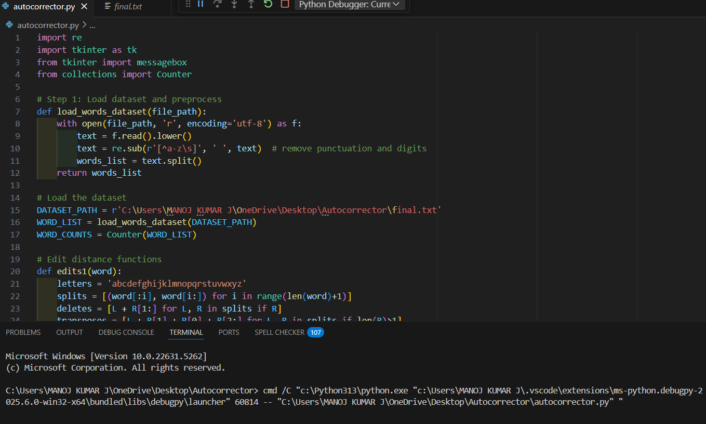
Implementation
Import Libraries

Slide 9
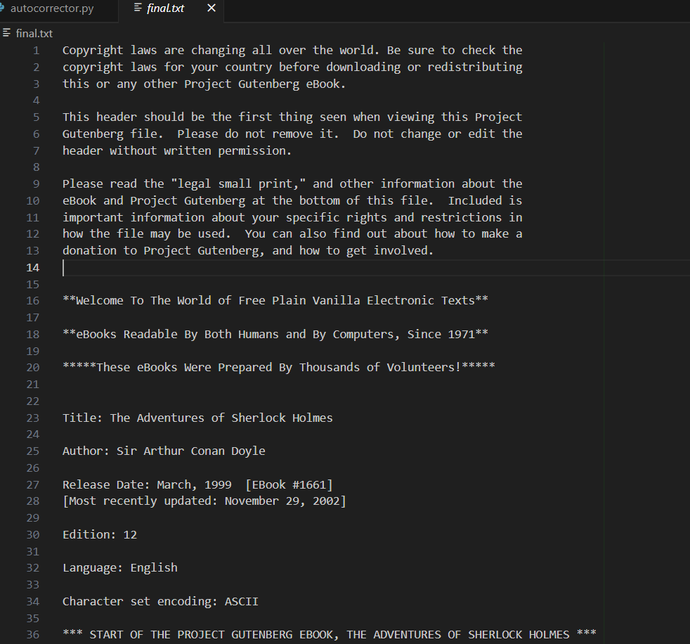
Implementation
Dataset:

Slide 10
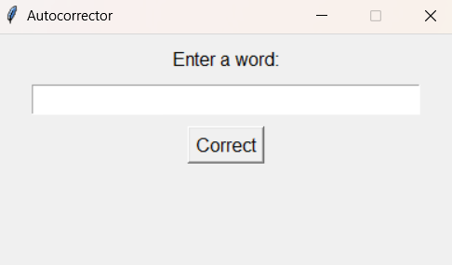
Result
OUTPUT

Slide 11
Comparison with existing work
“Spell Checking Techniques in NLP” – Khan et al., 2020 They explore rule-based, dictionary-based, and statistical methods, but their implementations are modular and not publicly deployable. In contrast, my implementation is self-contained, deployable locally, and openly accessible for modification or integration.
“Context-Sensitive Spelling Correction Using Neural Networks” – Yuan et al., 2021 This model incorporates deep learning for context-aware corrections but requires significant computational resources and internet access for cloud-based inference. In contrast, my project operates offline, is lightweight, and focuses on simplicity, making it ideal for educational use and low-resource environments.

Slide 12
Conclusion and Future Work
Conclusion
The autocorrector system developed in this project successfully demonstrates the application of basic natural language processing techniques to improve user input accuracy. By combining a user-friendly graphical interface with a robust backend correction engine, the system offers a practical solution for correcting misspelled words based on edit distance algorithms and word frequency analysis.
Future work
While the current version of the autocorrector system provides basic word-level correction using edit distance and word frequency, there are several opportunities for future enhancement to improve its functionality, accuracy, and user experience. One significant improvement would be the integration of context-aware correction, where the system not only checks individual words but also understands their placement in a sentence.

Slide 13
Reference
P. Norvig, “How to Write a Spelling Corrector,” [Online]. Available: https://norvig.com/spell-correct.html
V. I. Levenshtein, “Binary codes capable of correcting deletions, insertions and reversals,” Soviet Physics Doklady, vol. 10, pp. 707–710, 1966.
S. Jurafsky and J. H. Martin, Speech and Language Processing, 3rd ed., Prentice Hall, 2023.

Slide 14
THANK YOU

